Slide 1


You Only Look Once
Unified, Real-Time Object Detection.
201611772
Ko Ji Woong
Notes:
Hello. My name is Ko Ji Woong. I will present about You Only Look Once called YOLO.
YOLO is Unified, Real-Time Object Detection

Slide 2

1
Introduction
Human
Com
Object Detection?
Instantly know
what objects are in the image,
where they are, and how they interact
Don’t Know
what objects are in the image,
where they are, and how they interact
Notes:
Then Why need Object Detection? When humans see an image, They can instantly know what objects are in the image, where they are, and how they interact. But computers can't know that. So they need Object Detection.

Slide 3
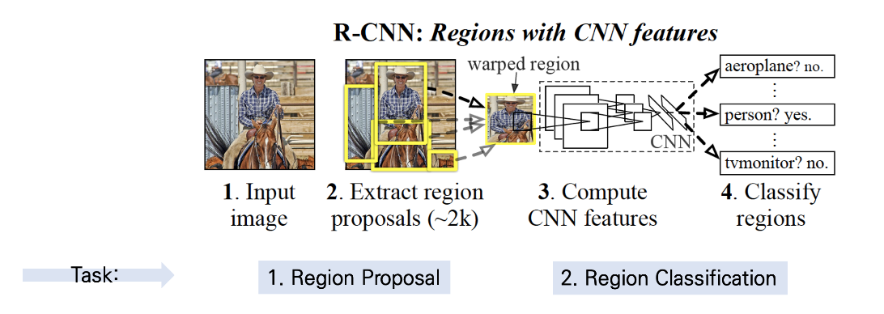
1
Introduction
R-CNN
Need 2 Stage
Region Proposal + Region Classification
Pipelines are complex, slow and hard to optimize
Notes:
One of the famous Object Detections is R-CNN.
R-CNN needs 2 stage for object detection.
Region proposal and Region classification.
Also R-CNN’s pipelines are complex so it’s slow and hard to optimize

Slide 4
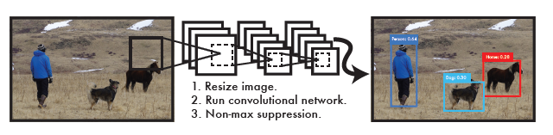
1
Introduction
YOLO
Simple
Reframe object detection as a single regression problem
Only Single Convolutional Network
Notes:
But YOLO is Simple.
YOLO reframes object detection as a single regression problem, So YOLO Only uses single convolutional network

Slide 5
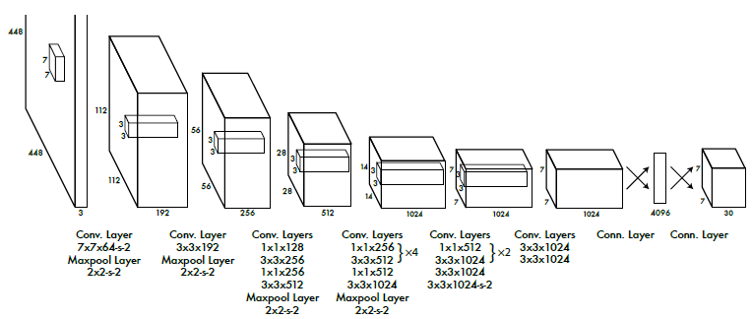
2
YOLO
Network Design
Inspired by the GoogLeNet model for image classification
24 convolutional layers followed by 2 fully connected layers
Notes:
YOLO's network architecture is inspired by the GoogLeNet model for image classification. It has 24 convolutional layers followed by 2 fully connected layers.

Slide 6
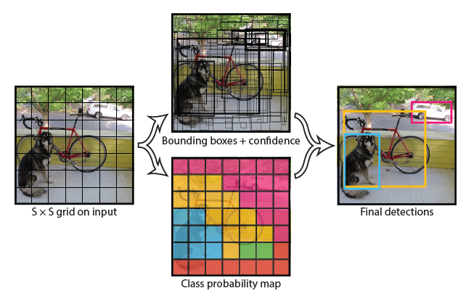
2
YOLO
How to work
YOLO divide the input image into an S * S grid.
Each grid cell predicts bounding boxes and confidence scores.
and also predicts conditional class probabilities at same time
Notes:
Then How to work?
First. YOLO divide the input image into an S * S grid.
Second. Each grid cell predicts bounding boxes and confidence scores. and also predicts conditional class probabilities at same time

Slide 7
Class-Specific Confidence Score
2
YOLO
How to work
Notes:
Then At the test time Using this formula, class-specific confidence scores for each box are calculated
Now YOLO can detect object

Slide 8
1. Spatial Constraint
limits the number of nearby objects that YOLO can predict.
So YOLO struggles with small objects that appear in groups
2
YOLO
2. Struggles To Generalize Objects In
New Or Unusual Aspect Ratios Or Configurations
Because YOLO has multiple downsampling layers from the input image.
limitation
3. Incorrect Localizations
YOLO's loss function treats errors the same in small bounding boxes and large bounding boxes.
Notes:
YOLO has 3 Limitation
First
Second
Third

Slide 9
1. Extremly Fast
Because YOLO doesn’t need a complex pipeline
2
2. Reasons Globally About The Image
YOLO
YOLO sees the entire image during training and test.
So YOLO makes less than half the number of background errors compared to Fast R-CNN
Benefit
3. Highly Generalizable
It is less likely to break down when applied to new domains or unexpected inputs
Notes:
But YOLO also has 3 benefits
First
Second
Third

Slide 10
3
YOLO
DPM
Other Fast Detectors
>
Comparison
Object Detecton
YOLO is faster or more accurate model
Notes:
DPM and Other Fast Detectors such as fast and faster R-CNN. They focus on improving the pipeline.
But YOLO throws out the pipeline entirely. So YOLO is faster or more accurate model than them

Slide 11
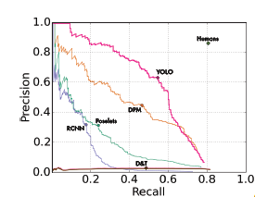
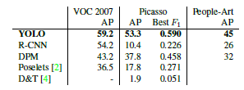
3
Comparison
ArtWork
Artwork and natural images are very different
But YOLO has good performance on both
Notes:
Artwork and natural images are very differen
So R-CNN has high AP. but it drops off when applied to artwork.
DPM maintains AP well But it is a lower AP
but YOLO has good performance on Both

Slide 12
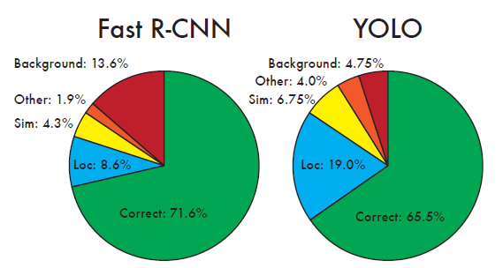
4
Combining
Error
Fast R-CNN makes much fewer localization errors
but almost 3 times more background errors.
Notes:
Comparing YOLO and Fast R-CNN, Fast R-CNN makes much fewer localization errors but almost 3 times more background errors.

Slide 13
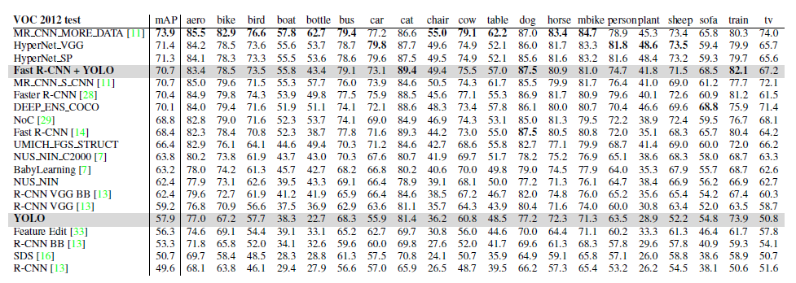
4
Combining
Fast R-CNN + YOLO
Using YOLO to eliminate background detections from Fast R-CNN get a significant boost in performance
Fast R-CNN + YOLO model is one of the highest performing detection methods.
Notes:
So By using YOLO to eliminate background detections from Fast R-CNN get a significant boost in performance.
Fast R-CNN is here Fast R-CNN+YOLO is here
It boost 5 spots up on the leaderboard.
Fast R-CNN + YOLO model is one of the highest performing detection methods.

Slide 14
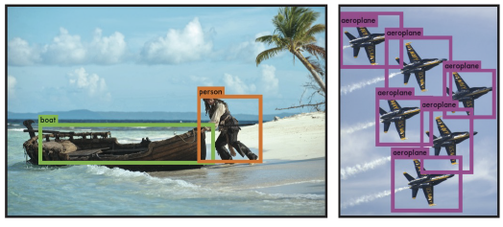
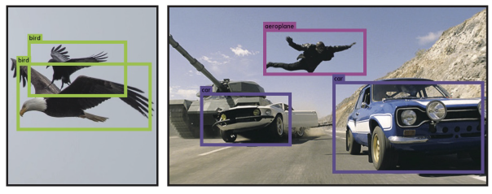
4
Combining
Real-time
When attached to a webcam, It functions like a tracking system
Notes:
YOLO is a fast, accurate object detector. so when attached to a webcam it functions like a tracking system

Slide 15

“THANK YOU FOR WATCHING”

